Slide 1
FUTABA
CAD

Slide 2
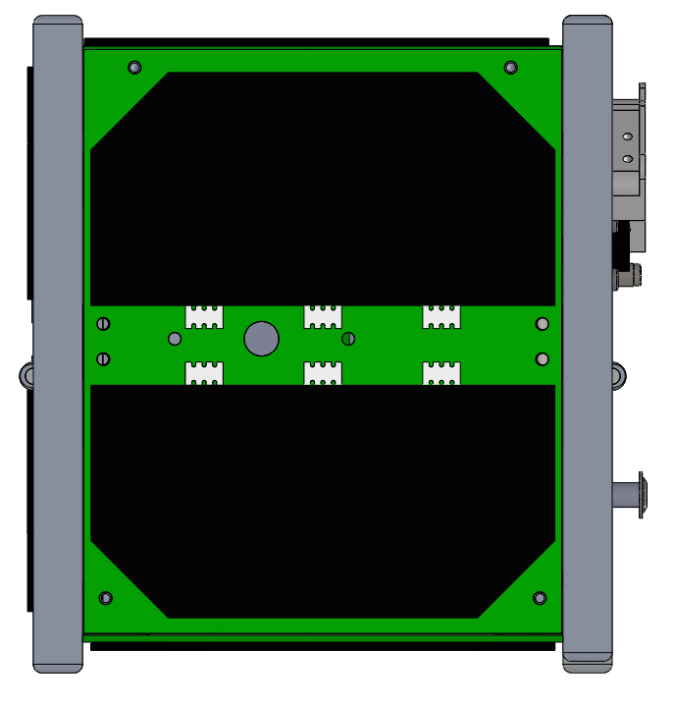
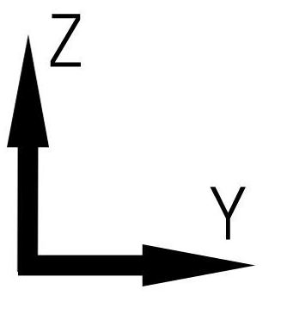
+X Panel
Solar Battery

Slide 3
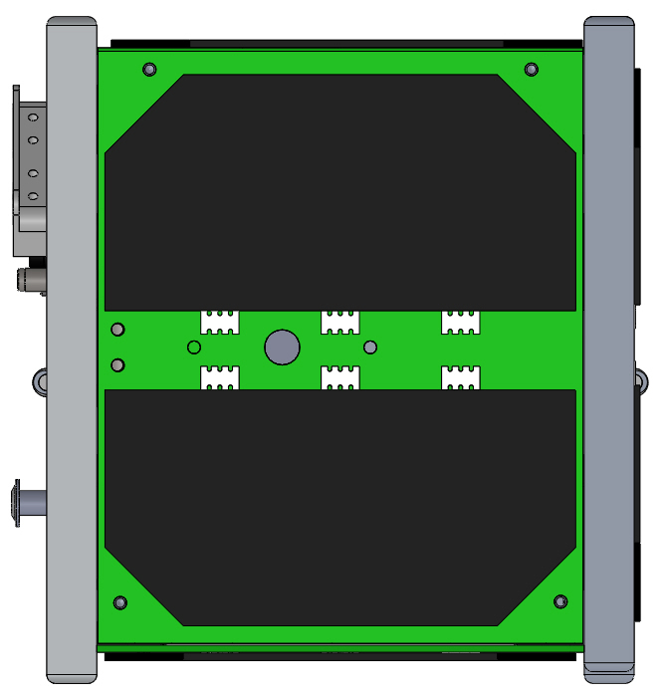
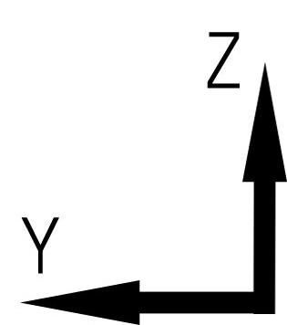
-X Panel

Slide 4
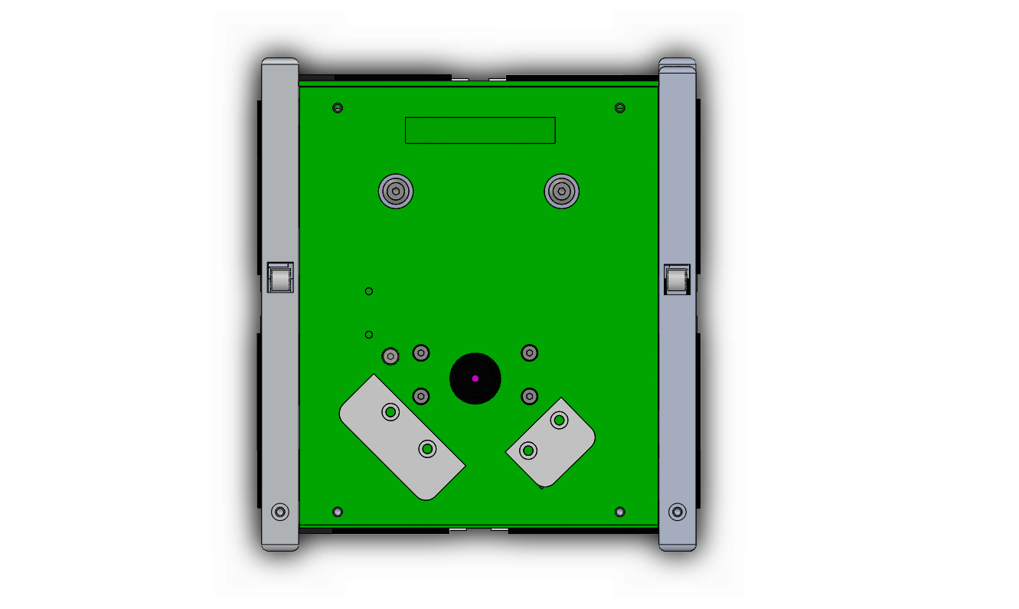
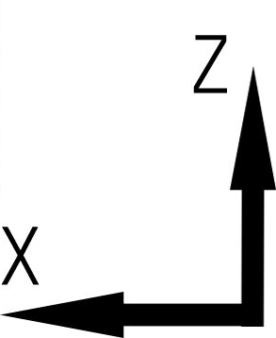
＋Y Panel(Deployment to Z)
Camera
Development
Switch
Now, our antenna is deployment to Z.
However, there is possible that
we are going to change to deployment to X by JAXA requirement.

Slide 5
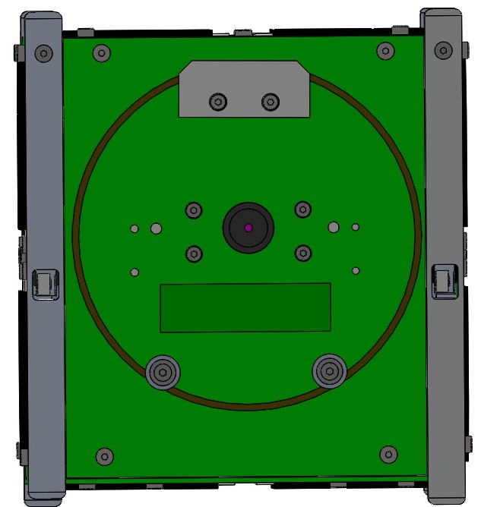
＋Y Panel(Deployment to X)
Camera
Development
Switch

Slide 6
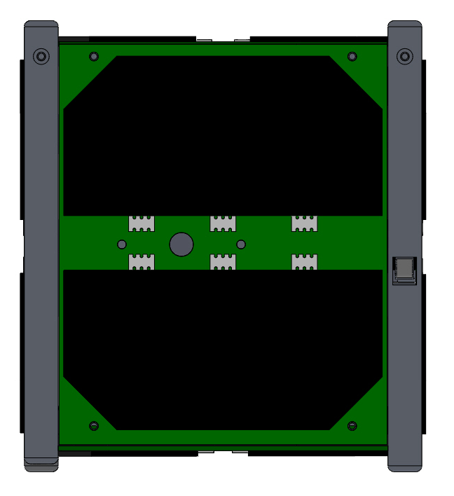
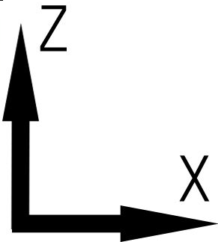
-Y Panel
Development
Switch

Slide 7
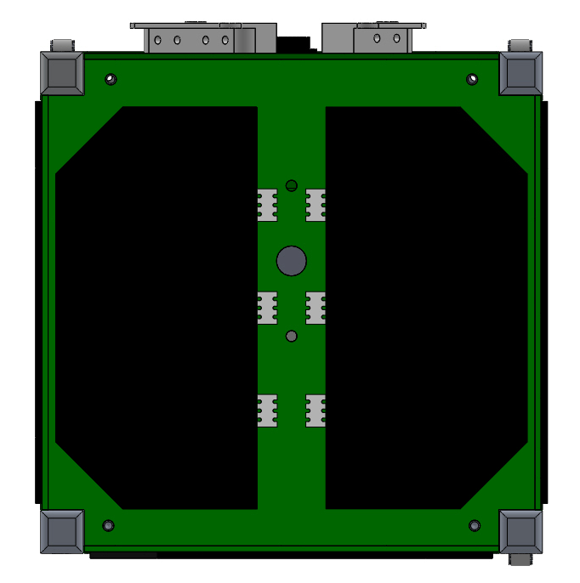
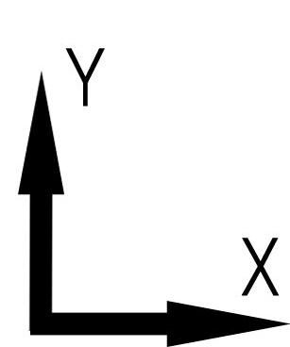
+Z Panel

Slide 8
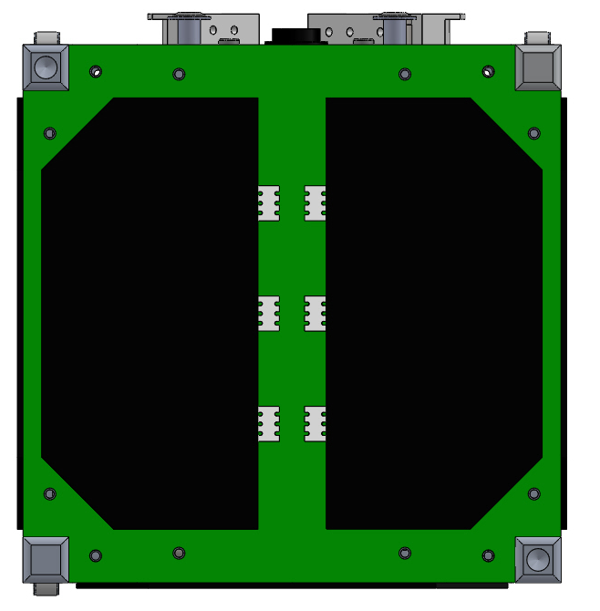
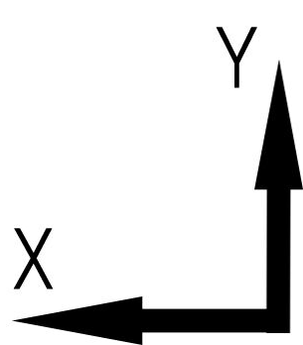
-Z Panel

Slide 9
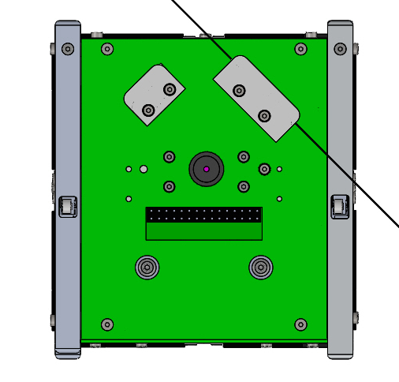
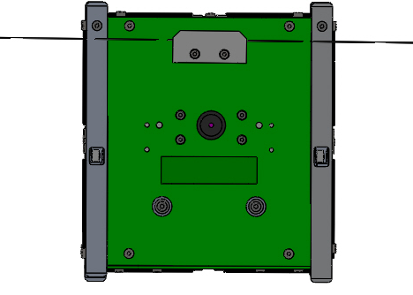
Antenna Deployment
Deployment to Z
Deployment to X
Now, our antenna is deployment to Z.
However, there is possible that
we are going to change to deployment to X by JAXA requirement.

